Slide 1
Gradiometers for Planetary Science
Mark Lindeman 2-20-2026

Slide 2
About Magnetic Gradiometers
B₃
A magnetic gradiometer measure the difference of magnetic field over a moderate distance
A first order gradiometer
measures the first derivative
Selects for local sources because signals fall off as R⁻⁴
This measurement results produces the magnetic field gradient tensor
Traceless 3x3 symmetric tensor
In source free region, there are only 5 independent components
Can measure this with 3 vector magnetometers, with (4 redundant measurements)
OK to only use a pair of magnetometers
Gives one component of the tensor, but that is still useful
Can rotate the gradiometer to get the full tensor, if needed
Second order gradiometers measure the second derivative,
Requires more sensors, with higher sensitivity
More strongly selects for local source because signal falls as R⁻⁵
B₁
B₂
B₁
B₂

Slide 3
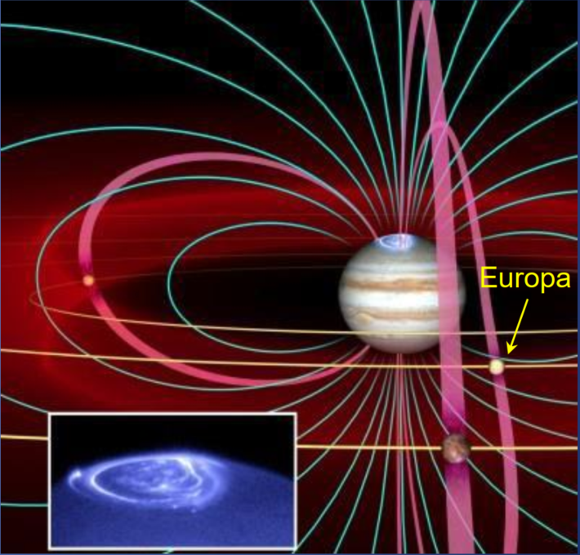
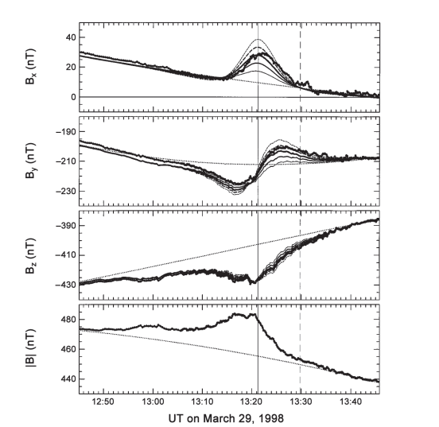
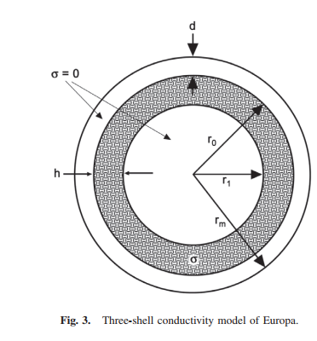
Jupiter Is a Huge Rotating Magnet
Jupiter's magnetic field is hundreds of nanotesla (nT) at Europa's orbit
Induces electrical currents in conducting materials
The Galileo Spacecraft observed a magnetic response from Europa
Margaret Kivelson Group at UCLA identified a magnetic dipole signal from Europa
Attributed to salty oceans under several km ice
Jupiter Magnetic Field
Europa's
Magnetic Response
Ocean Model

Slide 4
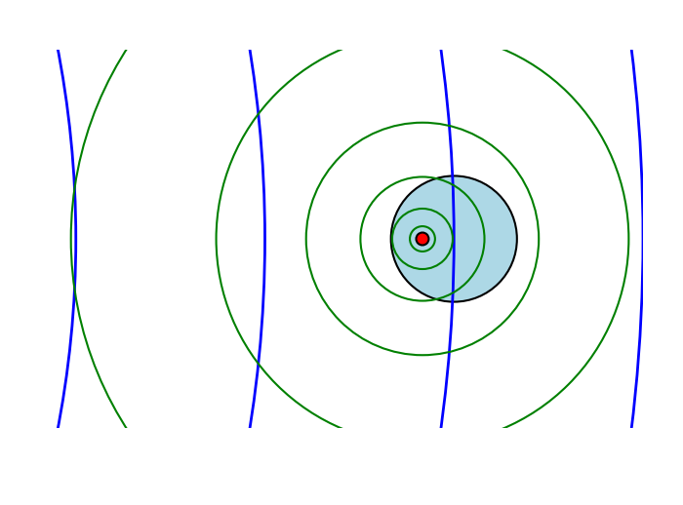
Idea: Features May Induce Significant Magnetic Gradients
Jupiter applies a varying magnetic field to Europa
This induces electrical current in conductive regions (of ocean)
Spatial variation in conductivity results in local variations in the magnetic field gradient
These local features can have a steeper gradient than nonlocal large-scale fields from distant sources
Provides a sensitive probe of local variations in conductivity or magnetism under the surface
A first order gradiometer measures the first derivative of the magnetic field, which is large near sources but falls off as R⁴
Conductive Region
External field from Jupiter or Solar Wind
(blue)
Induced field gradient from conductive regions
(green)
The induced magnetic field has a larger gradient than the solar wind field

Slide 5
Some Applications

Slide 6
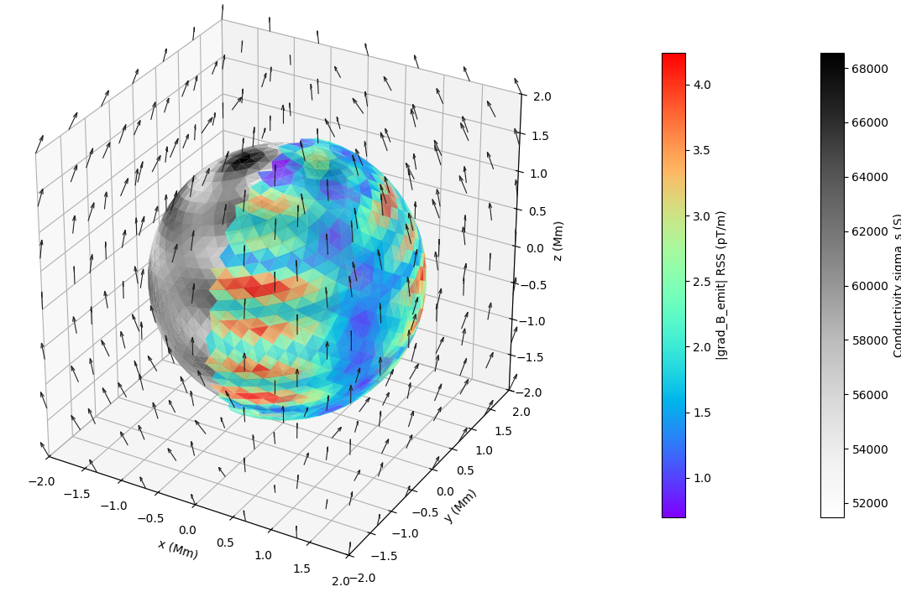
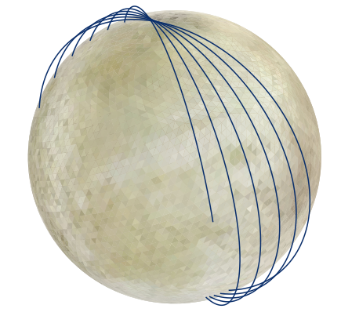
Water World Magnetic Gradients from Orbit
Induced Magnetic Gradient Features
(rainbow)
Gradient contains detailed information about planetary magnetism, induced currents, and conductivity
Conductivity Features of Ocean (grey)
Measure Magnetic Gradients to Observe Magnetic Features
Orbit 100 km above surface
Magnetic field Vectors

Slide 7
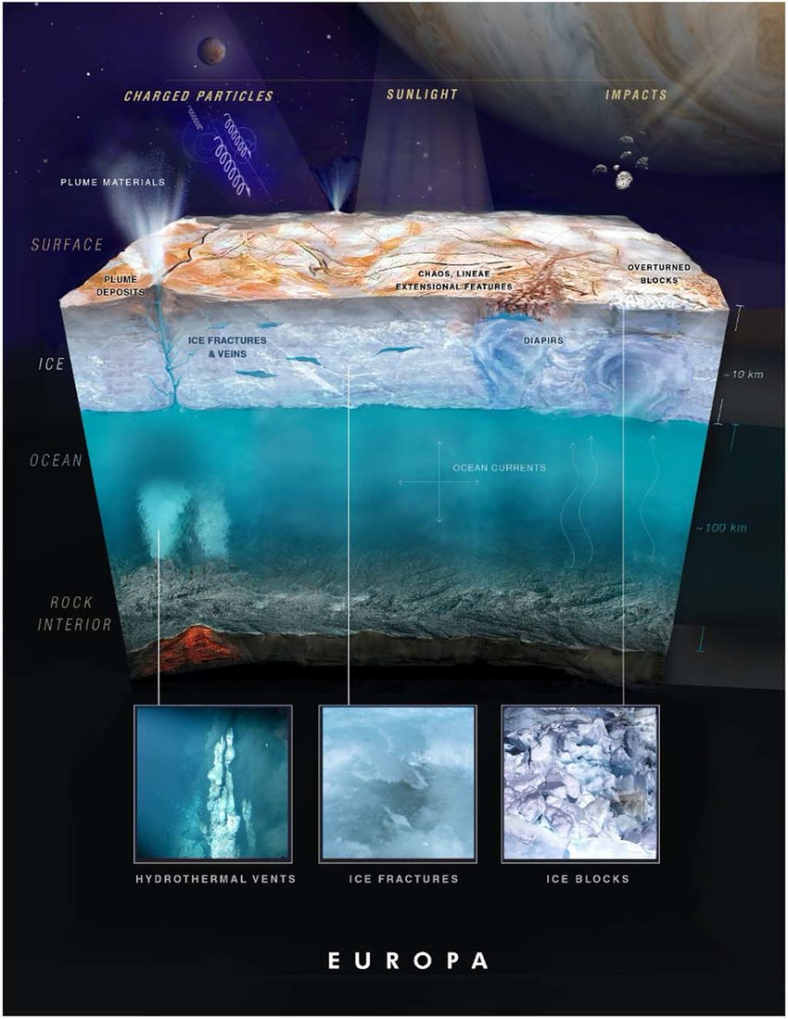
Propose to Search for Magnetic Features of Water Worlds
Magnetic environment induces currents in conducting features
Look for magnetic signals due to
Water in lakes and veins in the ice
Variations in ocean depth
Geysers
Ocean floor vents
Magnetic signals due to water flowing (magnetohydrodynamics)
Subsurface electrical currents

Slide 8
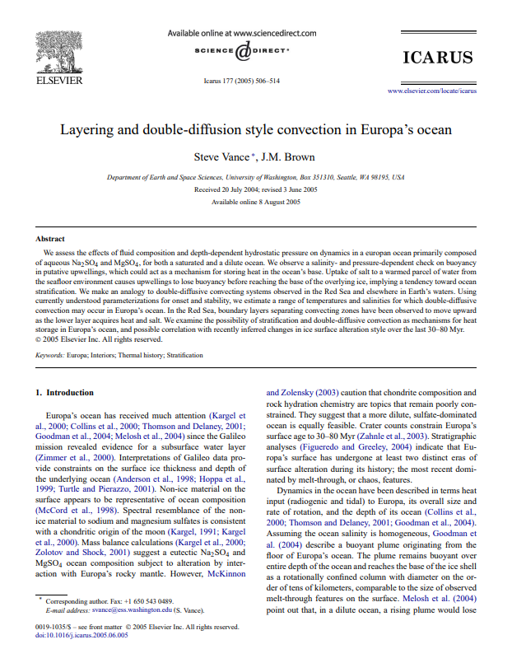
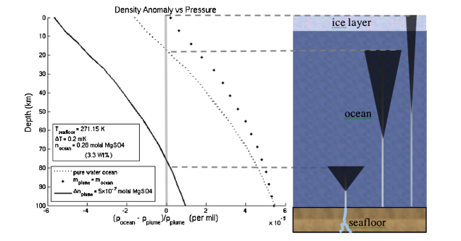
Convection and Geology
Predicted underwater plumes of highly saline water
Predicted convection, layering, diffusion dynamics in Europan ocean
Primarily composed of aqueous Na2SO4 and MgSO4, both saturated and dilute concentrations
Expect greatly varying conductivity in plumes, layers, and currents
Should result in fine-scale magnetic signals

Slide 9
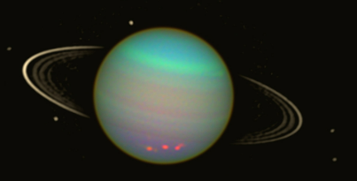
Uranus System
The Uranus system is highlighted in the Decadal Survey
Moons are likely water worlds, and targets for detailed magnetic surveying:
Ariel
Umbriel
Titania
Oberon
Also, the Magnetosphere of Uranus offers interesting plasma physics to study between visits to moons
Uranus and Moons

Slide 10
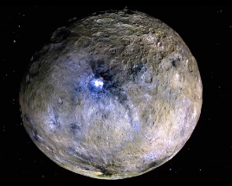
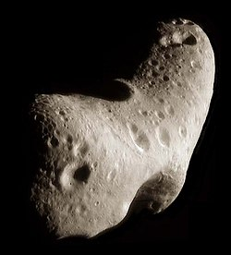
New Asteroid Science:
Ceres is a possible water world
Geological features suggest brine under the ice
Solar wind may induce a weak magnetic response from the subsurface brine
Previously undetectable asteroids
Fluxgates did not detect magnetism from weakly magnetic asteroids
These include on Eros, Lutetia, 67P, Braille, Steins, etc.
Map the weak magnetic fields of these objects
Provide evidence about composition and evolution
Solar wind induces signals from metallic parts
Eros

Slide 11
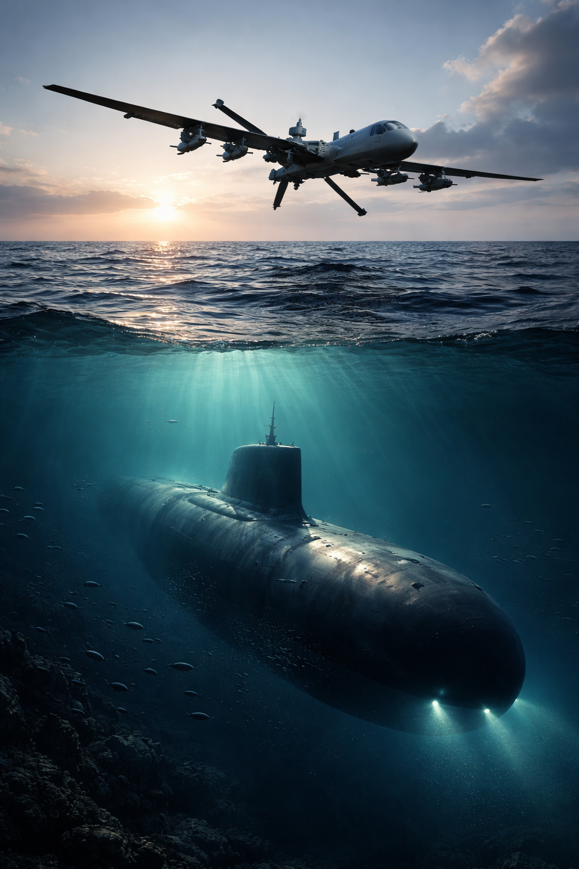
Detecting Terrestrial Magnetic Objects By Gradients
Nuclear subs:
Low magnetism Sub, 300 meters deep oceans can be detected
(Assume 1 % of magnetization of iron)
1st order Gradient from the sub is ~12% of Earth's dipole field gradient
2nd order gradiometer: the sub is 2600X earth dipole field gradient
Detectible by ~1 m SQUID gradiometers
Place on boat, buoy, or drone
Meteors and geological features
1 kg iron meter 20 m underground could be detected with similar technology

Slide 12
Why Use Magnetic Gradiometer for Water Worlds?
Induced Magnetic Gradient at 100 km (rainbow)
Picks out nearby sources like magnetic areas in planetary objects
Detects electrically conductive regions through their magnetic response to ambient fields
Even though the magnetic field is very smooth, the gradient is not smooth
Provides information about the magnetic structure of the body
Filters out large scale noise sources like the solar wind
5% variations in ocean conductivity produce pT/m gradients
Conductivity of Ocean (grey)
Magnetic field Vectors

Slide 13
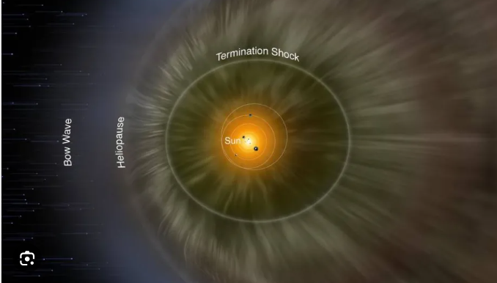
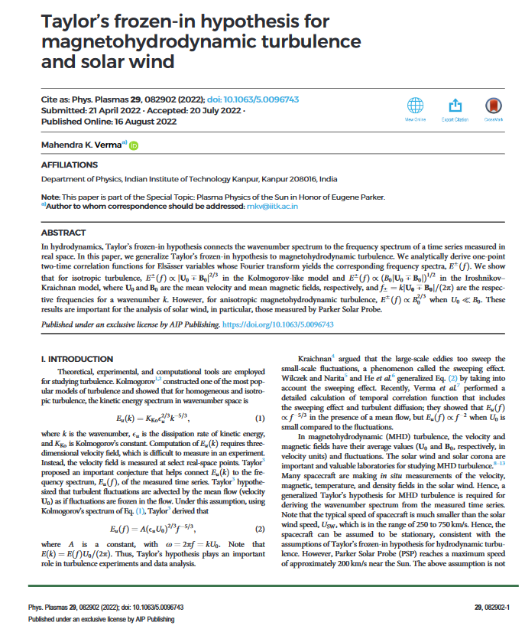
Magnetic Noise in Space
External-field variability may overwhelm magnetic signals, but not overwhelm the gradients
Solar wind is a source of magnetic noise varying up to 100 nT level near Earth
nT magnetic fluctuations dominate over the signals we want to detect from ocean worlds
Though the magnetic field varies a lot over time, it is fairly uniform on meter to kilometer spatial scales
In our initial modeling, we assume the solar wind as representative of external magnetic fields
We use a gradiometer configuration to effectively null out these long-range fields
Local magnet sources have a significant gradient on this scale
Large scale, far away magnetic sources have small gradients, decreasing as R⁻⁴

Slide 14
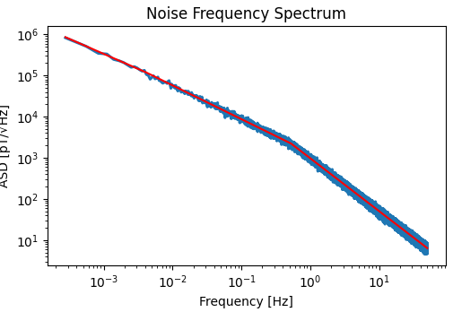
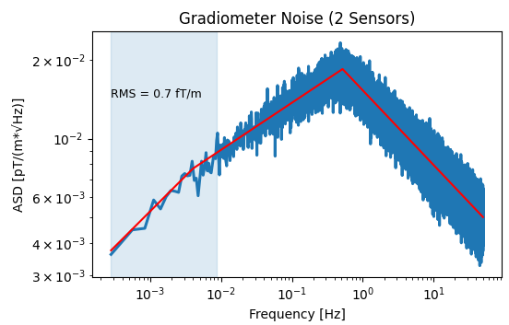
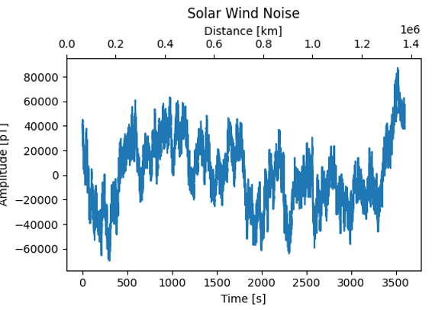
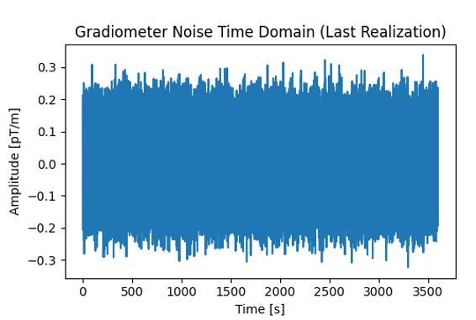
Filtering by Gradiometer
Raw Solar Wind Noise
Filtered Solar Wind Noise
Gradiometer removes long wavelength, low frequency magnetic signals such as from solar wind
Removes long term correlations in the noise
Preserves signals from nearby magnetic sources
These have much steeper gradients
Modeling predicts solar wind noise is filtered to ~1 fT/m
Easily sufficient to measure planetary magnetic gradients
Suppress

Slide 15
Modeling of Gradients

Slide 16
Magnetic Field Model
Induced Magnetic Gradient Features
(rainbow)
We modeled magnetic field gradients of a Europa-like body to verify implementation is practical
Conductivity is modeled as a thin shell
Modeled ambient oscillating magnetic field similar to Jupiter field on Europa
Faraday's law: changing magnetic fields normal to the surface induce toroidal electric currents on the sphere
Toroidal = no divergence, has curl
Electric current produces emitted fields
Solve self-consistently for currents and emitted fields to satisfy Faraday's law
Automatically includes magnetic field inductance
Solver is custom built in python
Validated against analytical solutions and symmetry tests
Conductivity Features of Ocean (grey)
Magnetic field Vectors

Slide 17
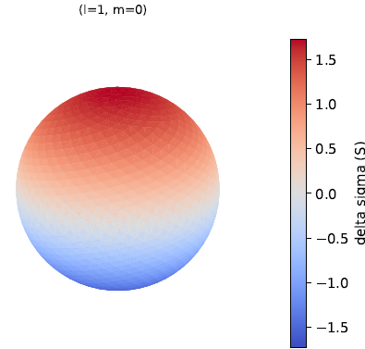
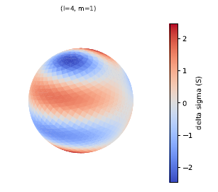
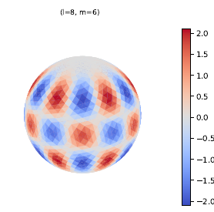
Approach to Modeling
Spatial distributions of Magnetic fields, conductivity, electrical currents are decomposed into spherical harmonics
Avoids issues with boundary conditions, 3D gridding
Only need to model harmonics on 2-D surface of sphere
Fourier analysis is used to decompose time dependence into frequencies
Coefficients of the spatial harmonics are encoded as phasors to represent time dependence
Modeled only toroidal currents on surface
Radial magnetic component produce toroidal currents
Assuming poloidal currents are negligible
Poloidal = diverging currents, no curl
Poloidal current implies charging and capacitance on the surface
Perhaps variations in conductivity can cause some divergence, which is currently neglected
Plan to validate this assumption
Spherical Harmonics

Slide 18
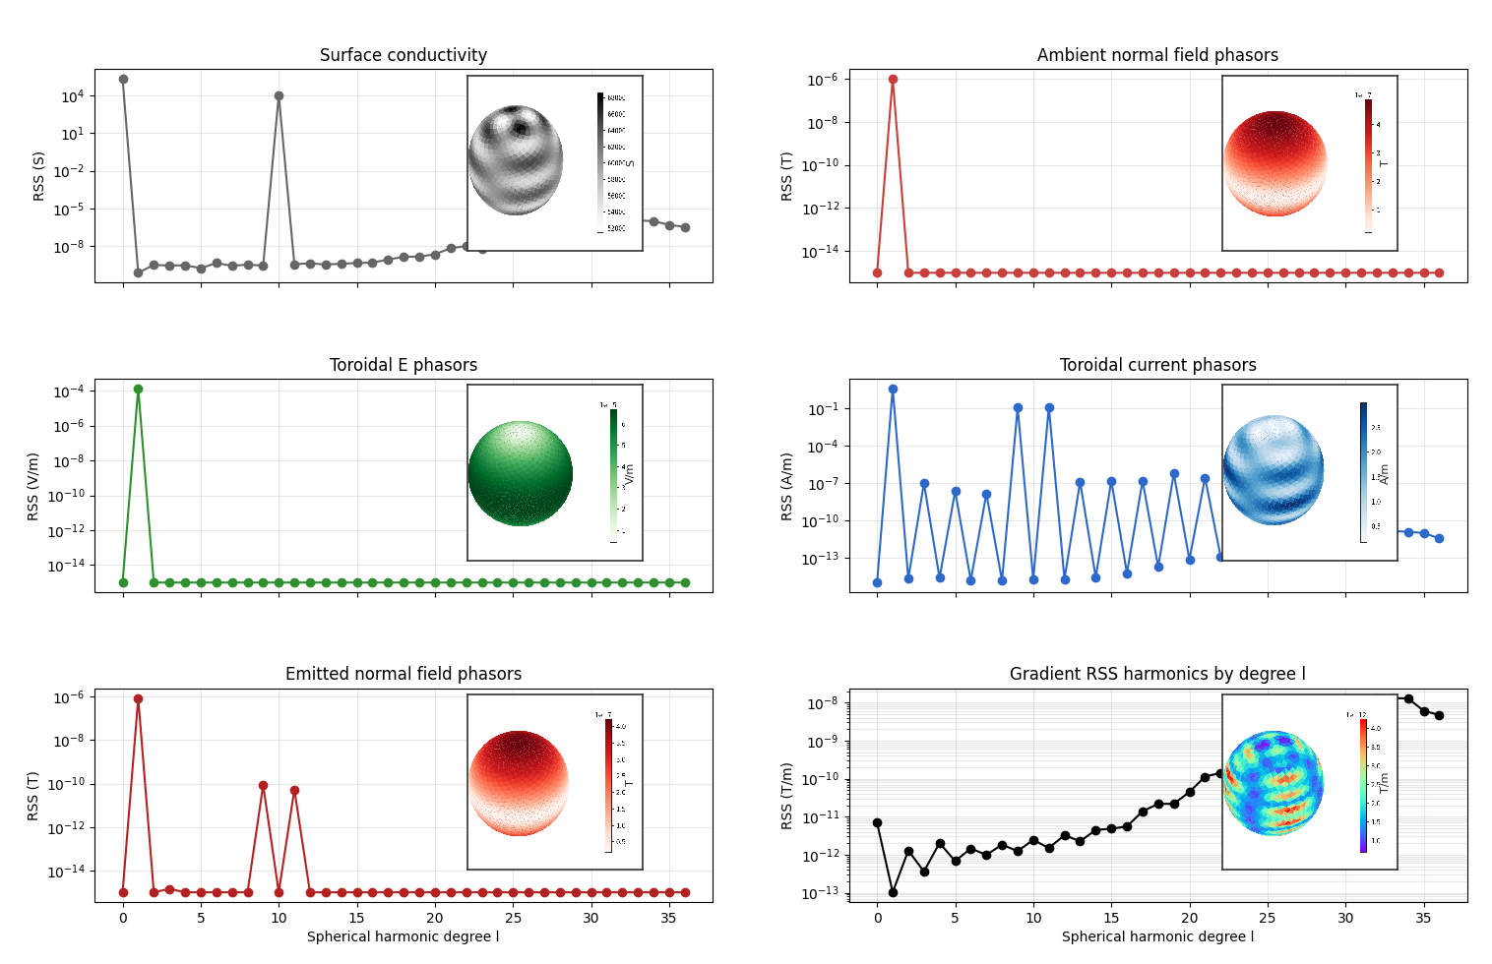
Calculations in Harmonic Components and Visualizations
Start with a distribution of conductivity in 'ocean’
Collapse to a surface conductivity
Represent as a sum of spherical harmonics (Y_{l,m} )
Example: (fig. 1) Uniform (Y_{0,0}) + 5% in higher harmonics (Y_{10,2}+ Y_{10,-2} )
Apply oscillating magnetic field
Z axis oscillating magnetic field component (Y_{1,0} ) (fig. 2)
10-hour period, 1 uT amplitude
Compute resulting electric field on Surface (fig. 3)
Find self-consistent solution
Induced current harmonics (fig.4)
Emitted mag. field by currents (fig. 5)
Calculate gradient of emitted fields (fig. 6)
Gradients provide Information about conductivity of oceans
(1)
(2)
(3)
(4)
(5)
(6)

Slide 19
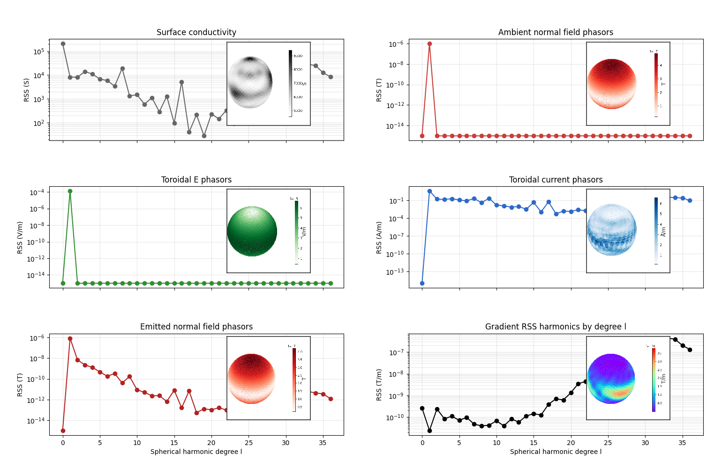
Multiple Conductivity Spatial Harmonics
Any conductivity distribution is modeled as a sum of harmonics
The harmonics combine nonlinearly with the ambient magnetic field harmonics to produce the emitted magnetic field
Features in the conductivity show up in the gradient data
Note that these plots of the gradients only show mean amplitudes
Really, the gradients contain much richer information than plotted:
3x3 tensors
Amplitude and phase information
Frequency dependent
Either the full gradient tensor or partial information can be measured to glean information about magnetic sources.
(1)
(2)
(3)
(4)
(5)
(6)

Slide 20
Gradiometer Implementation

Slide 21
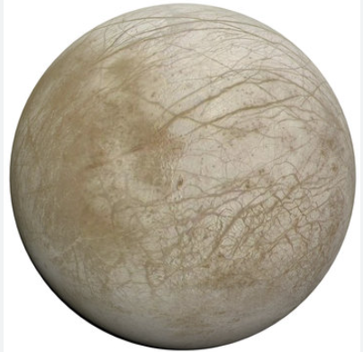
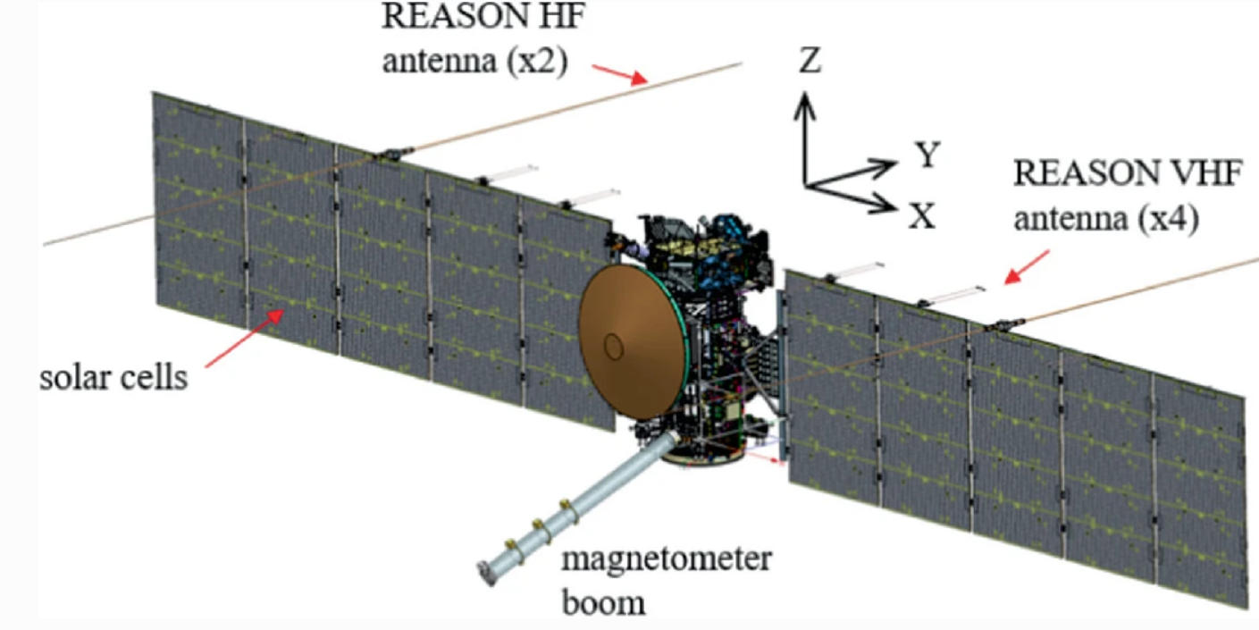
Gradiometer Requirements
Want to resolve gradients of ~ 1 pT/m to measure 5% variations in ocean conductivity
Bandwidth: 0 to 9 mHz used to resolve 160 km surface regions shown every 140 seconds
Well within the capabilities of existing magnetometers
Option 1: Single Spacecraft, 1 m long Gradiometer
Noise requirements:
White noise < 7.7 pT / √Hz @ 1 Hz
1/f noise < 380 fT / √Hz @ 1 Hz
Use HTS SQUID magnetometers
White noise: ~ 20 fT / √Hz
1/f noise ~22 fT / √Hz @ 1 Hz
Option 2: Paired spacecraft, 1 km apart
Noise requirements:
White noise < 7.7 nT / √Hz
1/f noise requirement: < 7.7 pT / √Hz @ 1 Hz
Use fluxgate magnetometers
White noise: ~50 pT / √Hz
1/f noise: 100 pT / √Hz @ 1 Hz
Option 3: 10 m boom, rotating flux gates to modulate signal @ 10 Hz, above 1/f noise
Noise requirements:
White noise < 77 nT / √Hz n/f noise
Use fluxgate magnetometers
White noise: ~50 pT / √Hz
10 m
SQUIDs
1 m
Fluxgates
1 km
Rotating
Fluxgates

Slide 22
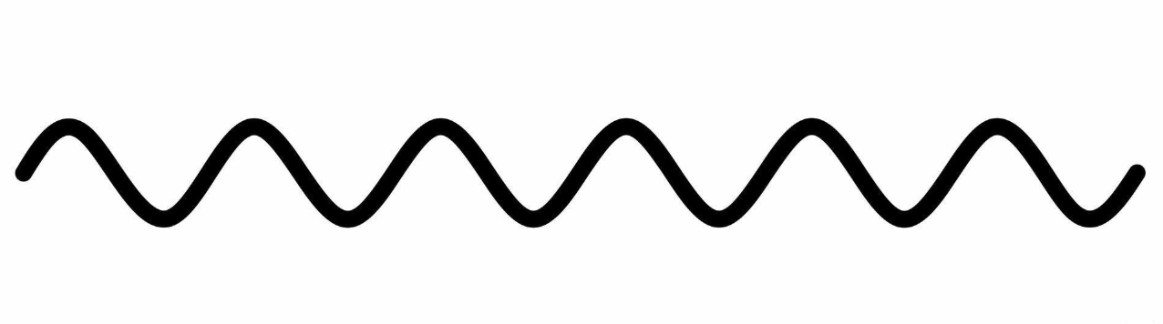
SQUID Technology
Superconducting Quantum Interference Device
Electric current quantum-tunnels through two insulating junctions
Tunneling depends on quantum interference of (+) and (-) waves
How the waves interfere depends on the magnetic flux in the loop area
Flux shifts the phase of (-) wave compared to (+) wave
Modulates the tunnel current
Extremely well calibrated: because depends on area of loop and flux quantum (h/2e)
Sensitive and very fast
Our proposed implementation: High Temperature Superconductor (HTS) SQUID system
Demonstrated 77K sensitivity: 1000 X more sensitive than ECM Fluxgates
30 fT / Hz^{1/2} noise
Much larger frequency range than other technologies (0 to tens of MHz), such as search coils
Wave of superconducting electrons
Wave (+)
(+)
Magnetic Flux into loop
Josephson Junctions: thin layers of insulator which block current
Current
(-)
Wave (-)
Phase shifts depend on magnetic flux

Slide 23
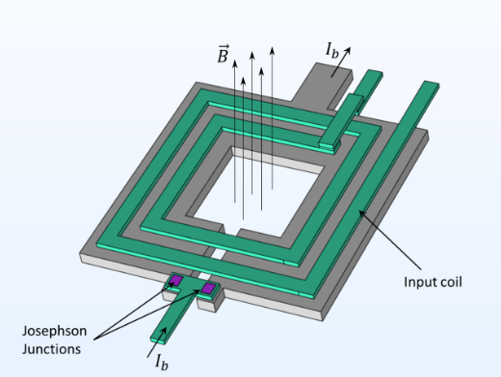
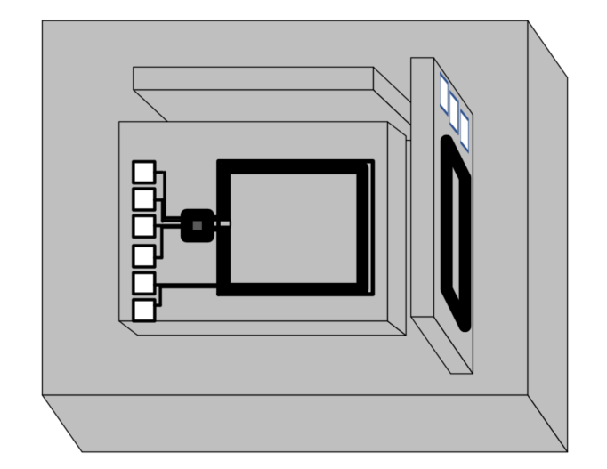
Implementation on a spacecraft
Couple SQUIDs with appropriate input coils are smaller than ~1mm
Wrap one in a 4 cm-scale XYZ package to measure the magnetic field vector in three dimensions
Mount multiple XYZ packages on a spacecraft boom
Electronic readout
Low noise HTS SQUID
(<1 mm)
Package of 3 for X, Y, Z components, with input coils , shielding etc. (~4 cm x 4cm x 4 cm)

Slide 24
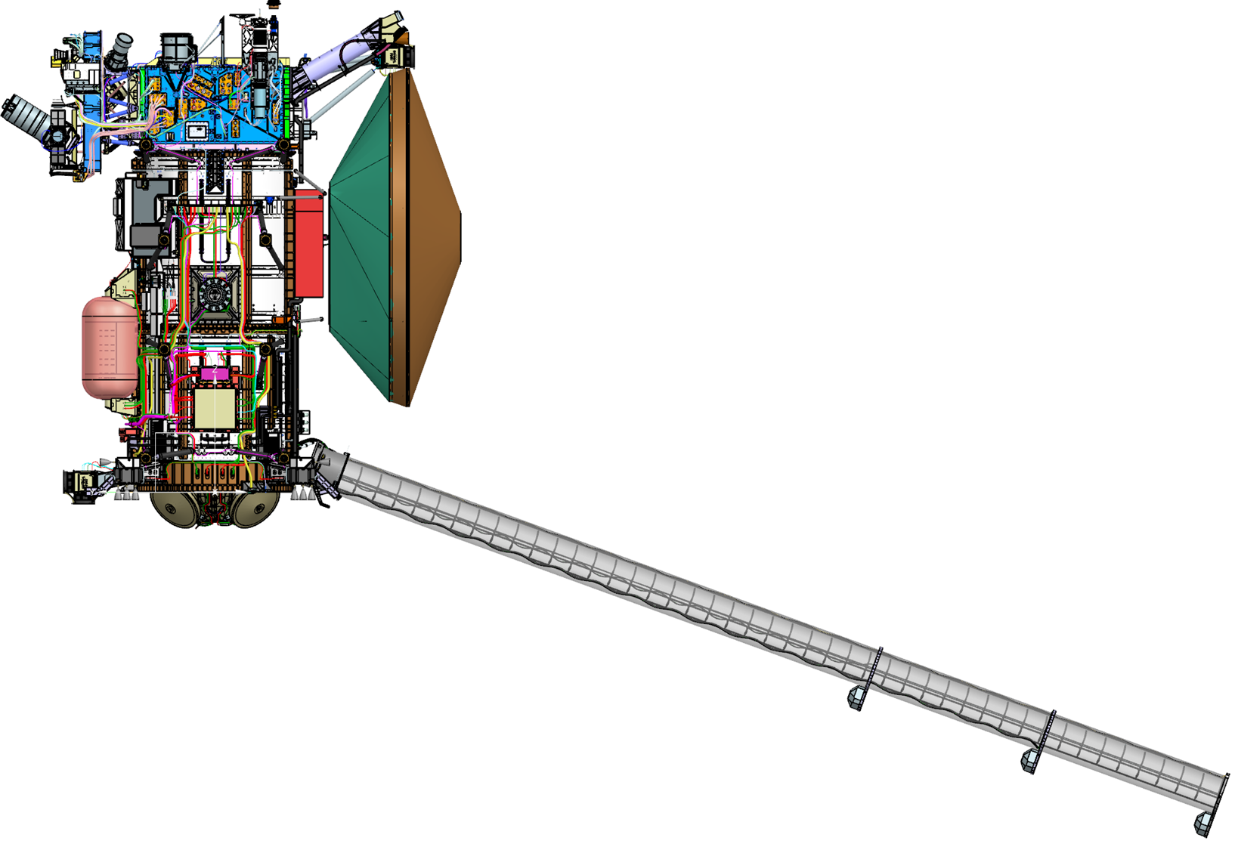
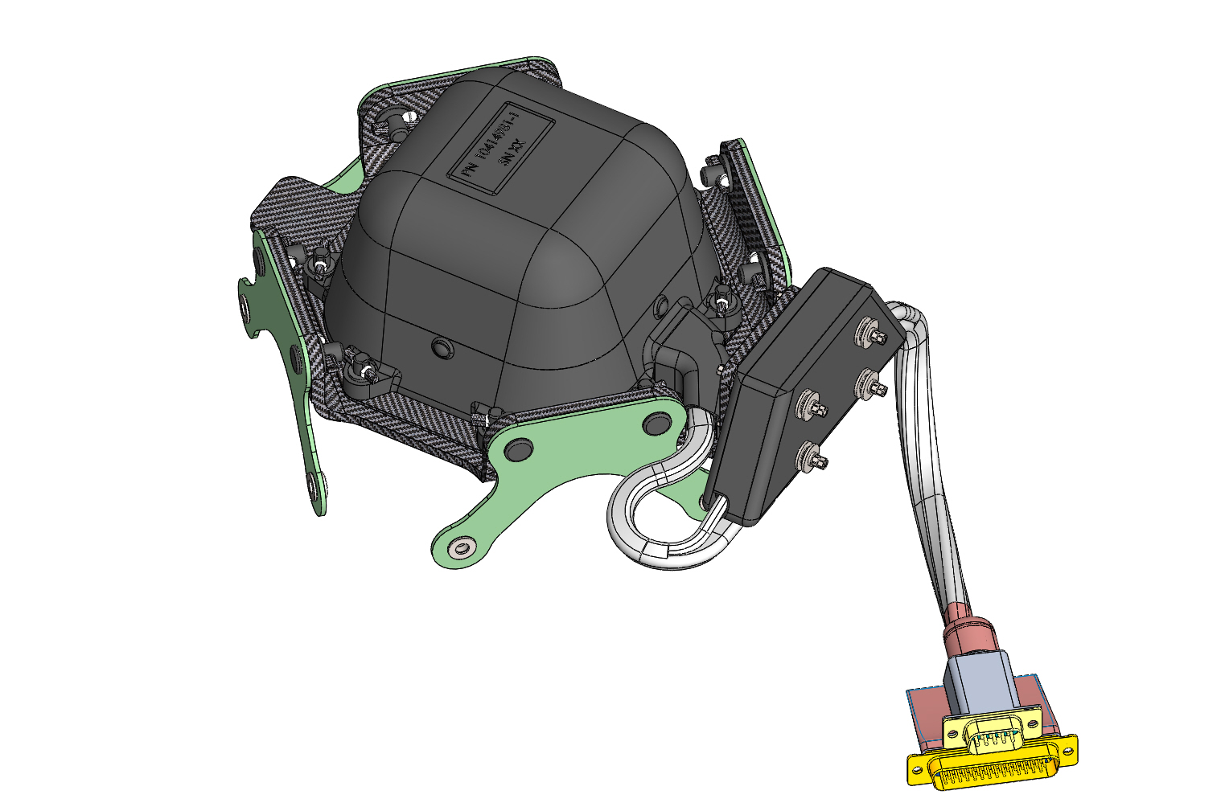
Fluxgate Technology
Fluxgate magnetometers such as The Europa Clipper Magnetometer work by applying an alternating magnetic field to a magnetic material
The ambient magnetic field adds to the applied field to determine how the magnetization saturates during each cycle.
The magnetization is measured by a readout circuit to find the ambient field
Placing these magnetometers on different spacecraft with km of separation would provide a sensitive measurement of the magnetic gradient (pT/m level)
About 1000 X less sensitive than SQUIDs, but workable with a long baseline
Polarized
(magnetic
domains)
8 kHz
Cycle
ECM sensors
Onset of saturation is a measure of the ambient field
Reversed polarization

Slide 25
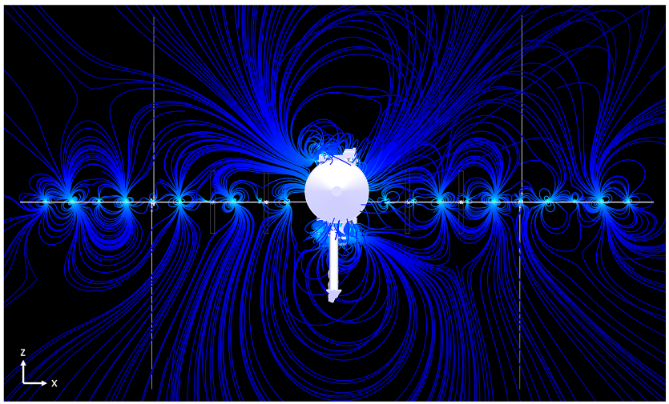
Spacecraft noise
Issue: Spacecraft noise can dominate the magnetic field
Spacecraft Design
Short Coax cables should have very low emissions
Block low frequencies with capacitors and use ac electronics
Concentrate digital circuitry in small shielded boxes
Power with stable ac or DC circuits whose frequency content is not greatly affected by varying loads
Ideally signaling is via fiber optic
Chopping: Could rotate spacecraft to separate signal from noise
Fitting data from several sensors can separate this noise from the ambient field
Numerical simulation shows that fitting magnetic field of several sensors can effectively separate spacecraft fields from ambient field
Gradiometer using paired spacecraft greatly reduces impact of spacecraft noise
EC Spacecraft Magnetic noise (C. Cochrane)

Slide 26
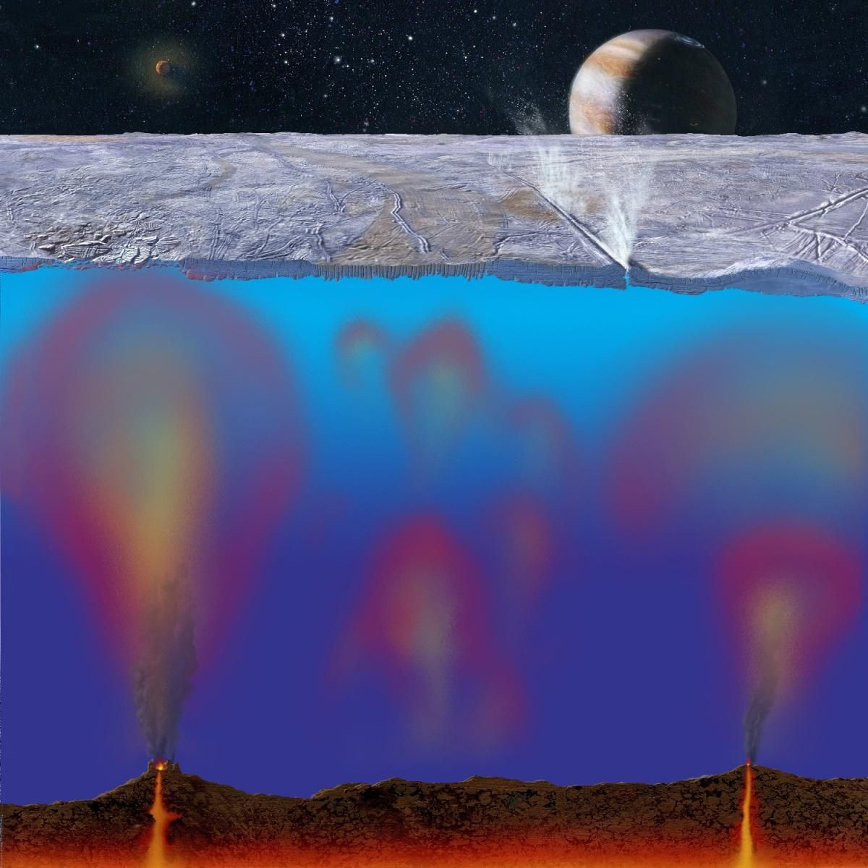
Conclusions
Magnetic gradiometry may open a new window into ocean worlds hidden under ice
Subsurface ocean mapping of subsurface lakes, ocean convection, hydrothermal vents, saline gradients
Targets for gradiometer technology
Weakly magnetic asteroids
Terrestrial magnetic objects such as subs, meteors, and geological formations
Observable at the pT/m sensitivity
Calculations indicate that existing magnetometers can enable magnetic radiometry
SQUIDs or Fluxgates could be used depending on the implementation

Slide 27
Back Up Slides

Slide 28
Orbital Properties
Sampling the magnetic field from orbit
100 km altitude
Orbital period = 2.086 hours
speed = 1389.215 m/s
Initial Modeling used 160 km ground pixels (not shown)
node drift per orbit = 1.605 nodes
114 s crossing time
Orbit 100 km above surface

Slide 29
Detecting Terrestrial Magnetic Objects
Assume a 500 m steel submarine, with magnetism reduced by 100x through major mitigation
Assume 10 m/s boat or aircraft near surface of ocean
Magnetic field from the sub at the surface is only 5 ppm of Earth's dipole field
Sample every 300 m / 30 seconds for 30 mHz sampling bandwidth
First order gradiometer:
Gradient from the sub is ~12% of Earth's dipole field gradient
The sub is detectable from Earth's surface or a low-flying drone
1 m first order gradiometer
Magnetometer 1/f noise requirement ~ 7 pT/Hz^{1/2} @ 1 Hz
Well within capabilities of HTS SQUID magnetometers (22 fT/ sqrt(Hz) @ 1 Hz)
Research to learn if devices that tolerate Earth's field have this sensitivity. May have to use bucking coils
Need measured 1/f noise for UCR devices that can handle ambient fields
Second-order gradiometer to help separate from Earth's field
Gradient is 2600x Earth's field gradient
2 m second order gradiometer
Magnetometer noise requirement: 1/f noise ~1 pT/Hz^1/2 @ 1 Hz
Well within capabilities of HTS SQUID magnetometers

Slide 30
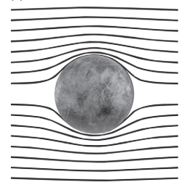
Europa's Response to Jupiter Field as Seen by Galileo
The Galileo Spacecraft observed a magnetic response from Europa
Margaret Kivelson Group at UCLA identified a dipole signal from Europa
Attributed to salty oceans under several km ice
Conductive ocean response to oscillating field from Jupiter
Potentially habitable world
We would like to know more about the subsurface ocean
Measure magnetic response
Khurana et al.: Electromagnetic Induction from Europa's Interior
Inferred conductive ocean under the ice of Europa

Slide 31
Conductors Respond to Magnetic Fields
Application of a changing magnetic field on a conductor induces an electrical current in that conductor
The electrical current induces a magnetic field that opposes the change in the magnetic field
The amount of induced field depends on
The area of the conductor
Its electrical conductivity
The rate at which the magnetic field is changing
Measurements of the response can be used to infer the presence of an electrically conductive material, as in a metal detector.
Even works if the conductor is a planetary sized object like a salty ocean
Applied Field Changes
Electric current
Magnetic Response

Slide 32
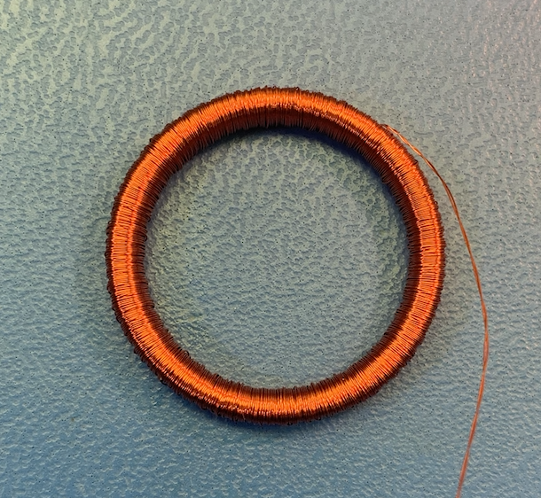
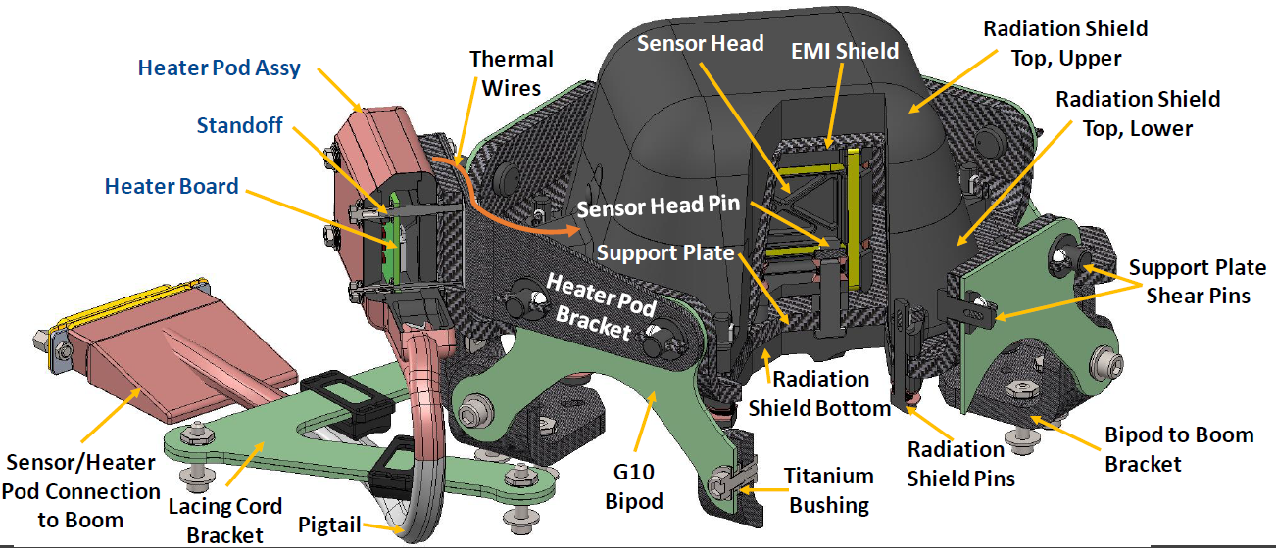
About the ECM Fluxgates
Key Parts
Rings of soft magnetic alloy which magnetize in an external field
Drive and sense coils that detect the magnetization
Employed lots of plastics and adhesives with carbon added for moderate conductivity to provide shielding and protect against IESD
Use of metal was minimized
Temperature: regulated to -110 C at Jupiter
Two magnetic rings, with sense 3 coils to detect magnetization in X, Y, Z directions

Slide 33
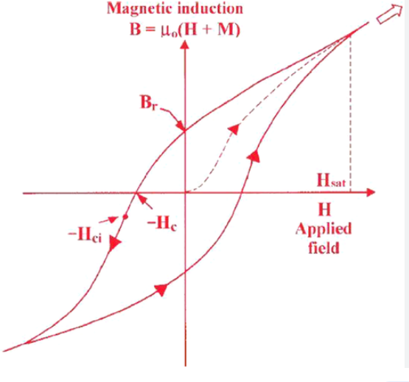
Fluxgates: Operating Principle and Noise
Strong Magnetic field
Fluxgates contain a soft magnetic material
Magnetic domains align with external magnetic field
Hysteresis: Domains do not perfectly align; they lag behind the external field
Small hysteresis at large fields because all domains are aligned, larger at zero field
ECM fluxgates apply an oscillating field at 8 kHz.
The hysteresis loop causes a magnetic response at 16 kHz (and other multiples)
The 16 kHz signal depends on the strength and direction of the external field
The signal has noise because domain flips are partly random (~30 pT/Hz^1/2)
(magnetic
domains)
Magnetization Curve
8 kHz
Cycle
No external field
Intrinsic noise due to magnetic domain realignment
Reversed Strong
Magnetic field

Slide 34
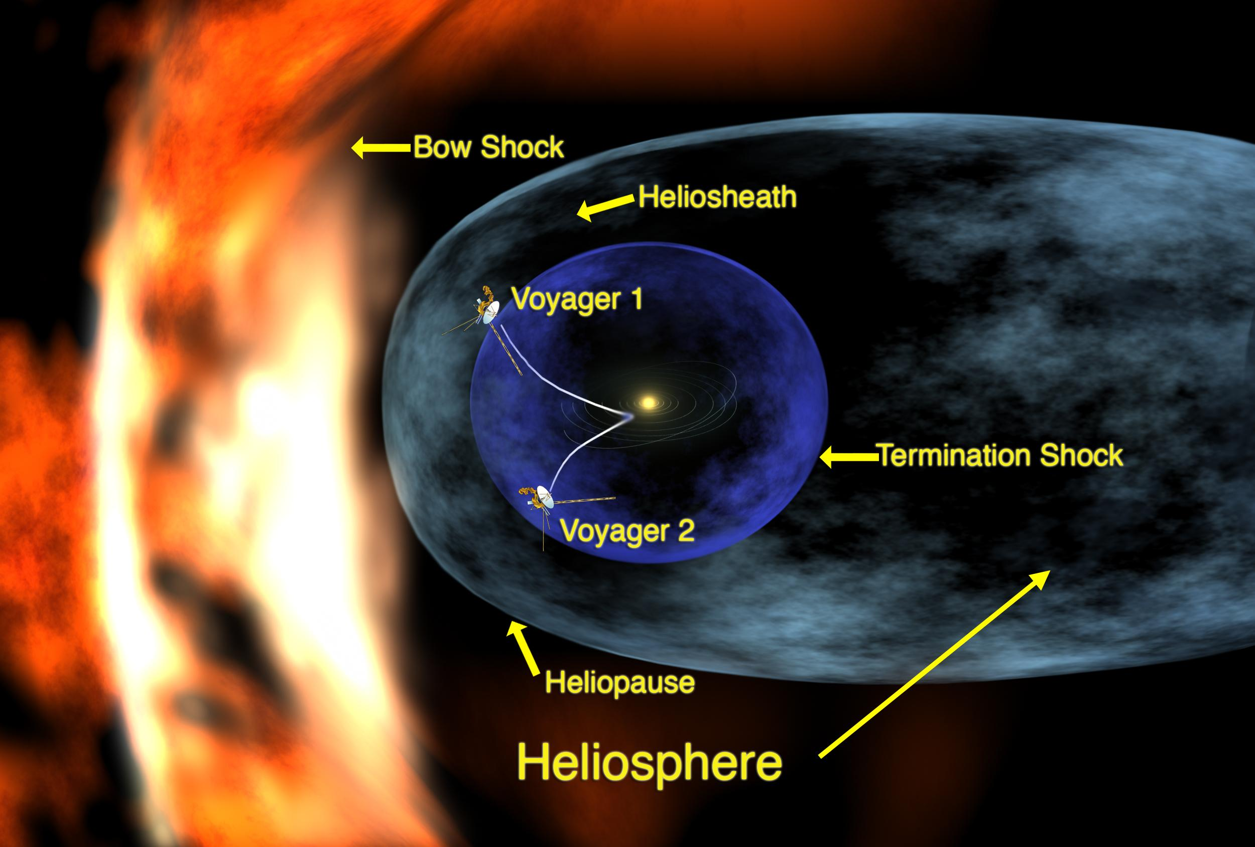
Heliopause measurement
Magnetic Measurements out at the heliopause require more sensitivity because magnetic fields are very small
However, would take decades to get there

Slide 35
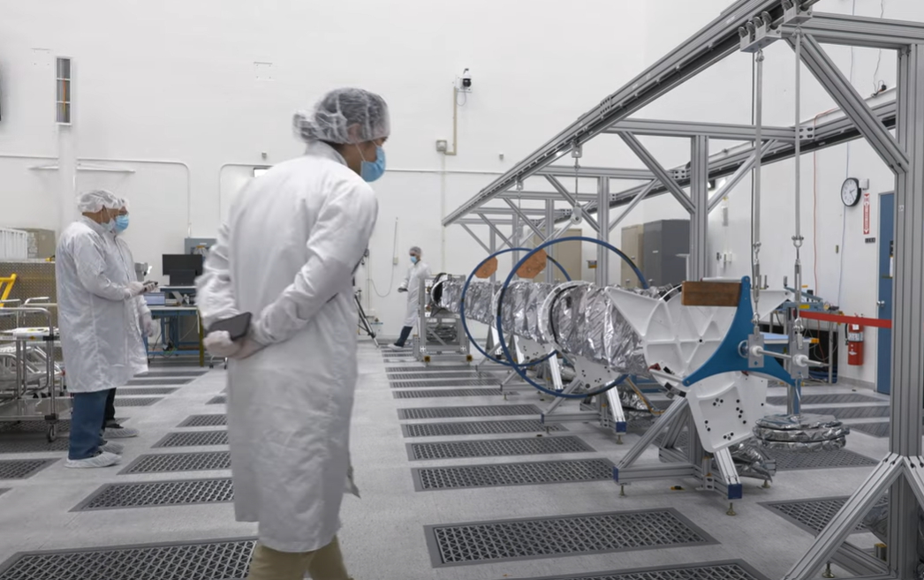
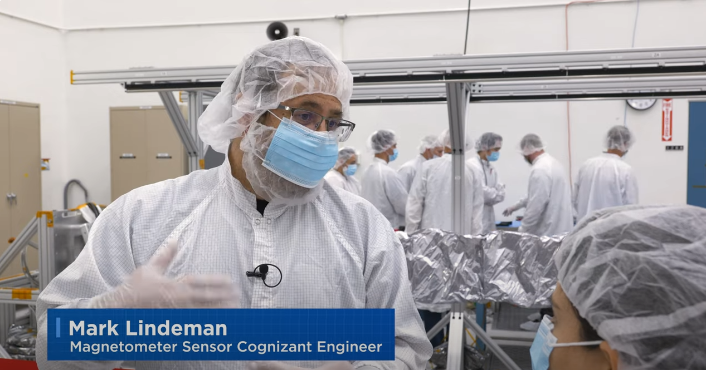
Europa Clipper
Europa Clipper Magnetometer (ECM) on boom
The planned measurements will provide information about the
Ocean depth
Salinity
What could we do with much more sensitive magnetometers
Three fluxgate magnetometers located on a boom to isolate from spacecraft magnetics
1
ECM sensors
Notes:
Possible hand over to Karen
Harness builds 3 sets. One set delivered to ECM. One set split to vault (int/ext), prop mod, and boom.
ECM test and cal on spare.
E2E electrical on actual flight cable.

Slide 36
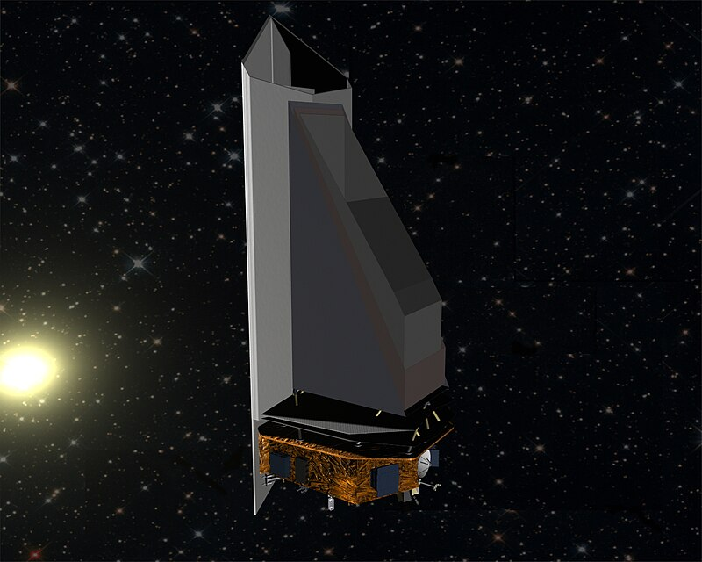
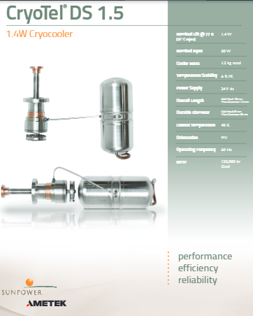
Issue 3: Low Temperature Operation
A SQUID gradiometer must operate at 80 K or below
Solutions:
Passive cooling possible
NEO surveyor will passively cool IR detector arrays to 40 K at Earth Lagrange point (L1)
Cooling tiny SQUIDs, which use nW of power, is much easier
Objects at Saturn and Uranus are typically below 80 K
Closer to the sun, cryocoolers are also an option
Small cryocoolers are available that weigh 1.2 kg and use 30 W
NEO Surveyor

Slide 37
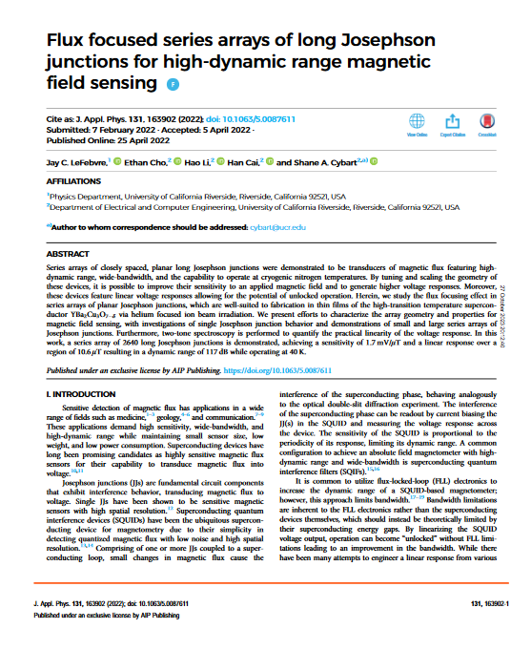
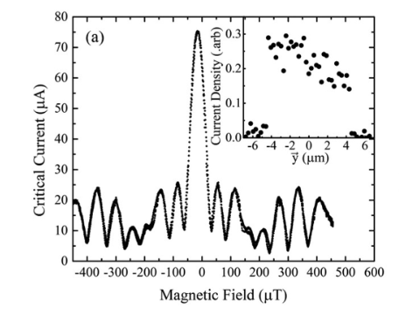
Issue 4: Tolerance to Noisy Environments
Issue: Can quantum interference devices handle a noisy magnetic environment
A variant of YBCO SQUIDs, called Josephson junction arrays, works in high-field environments
UC Riverside reports "developing superconducting magnetometers designed … with enough dynamic range to operate unshielded with background magnetic fields, such as that of the Earth"
Replace the SQUID loop with a tiny junction-only device
The effective junction size is small enough that flux does not saturate (micron scale)
Earth field

Slide 38
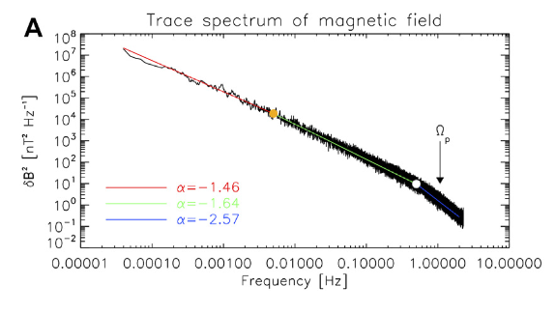
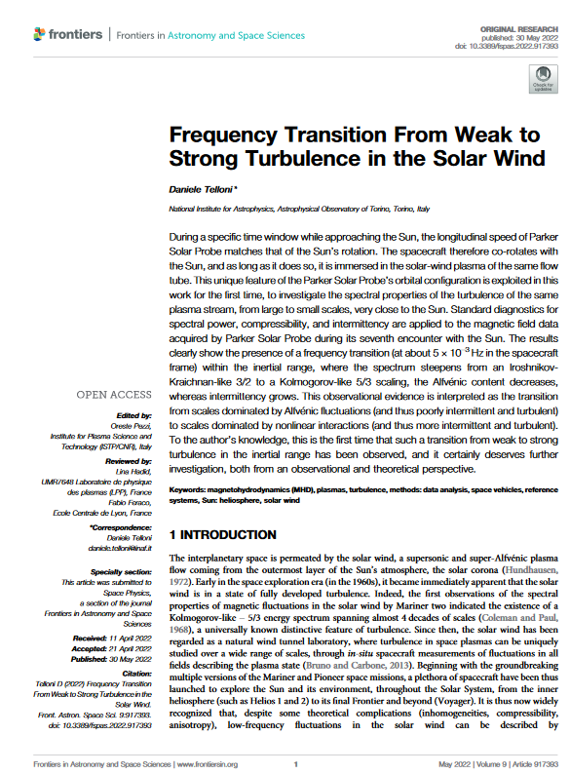
Solar Wind Model
My simulations of gradiometer performance incorporate a solar wind model
Taylor frozen flow model:
Solar wind drags magnetic field lines with it.
Field is not changing in a comoving frame
Power spectrum of solar wind magnetic field noise is well known
. (Source: Daniele Telloni, "Frequency Transition From Weak to Strong Turbulence in the Solar Wind") (Near Earth)
Given the power spectrum and velocity of the solar wind , the simulations calculate the spatial variations in the magnetic field
Shows that a gradiometer effectively filters out solar-wind magnetic noise
Solar Wind Power Spectrum

Slide 39
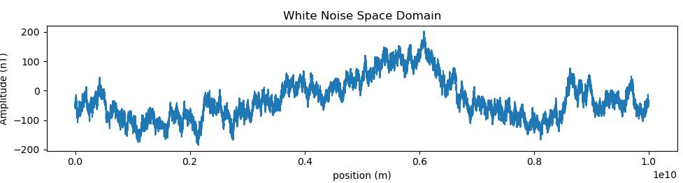
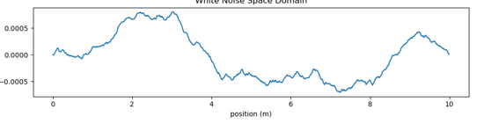
Numerical Model of Solar Wind Magnetic Noise
Noise varies greatly on large scales:
A gradiometer measures differences in field across its length (A-B)
Gradiometer filters out large scale variations, but detects small scale ones
Should be able to detect gradients of size 100 fT/ meter or larger
Back of the envelope calculations: conductive features of Europa to generate gradients detectible at 50 km altitude
~100 nT
Hardly varies at all on the scale of a 10 m long gradiometer
A
~500 fT
B

Slide 40
Asteroids - Ceres Model

Slide 41
Additional Ideas
Are their significant electrical currents in aquifers?
Do poiloidal currents charge Europa enough to have a significant E field?

